Slide 1
Product Development Lab
Automotive Sensor Group
PT TDK ELECTRONICS INDONESIA
A TDK Group Company TPS Business Group • SCA
Batam , Indonesia

Slide 2
0
Project Modification RTC machine Angelantoni at PD Lab
Project Objectives :
To fix the NTC cable issue, which is frequently tangled
To fix the issue with jammed and stalled NTC carrying baskets
To reduce the duration of time needed for the sample to move from one bath to another
Project Deliverables :
The new modification Mechanical RTC machines work on target,
The electrical control can be used and running in the new modification. mechanical RTC machine
Project Timeline :
16th January 2023 – 30th January 2023
Project Supervisor:
Mr. Nasporida & Ms. Fithriyyah
Project Team:
Andreaski Pangestu
Cikal Hara Siampo
Cristian Imanuel Pasaribu
Esther Jesica Saragi
Kristian Kevin
Project Support team (Internship PENS & Technician ) :
Mr. Andi Kurniawan
Sander Antonius Balisa
I Made Aditya Rama Putra

Slide 3
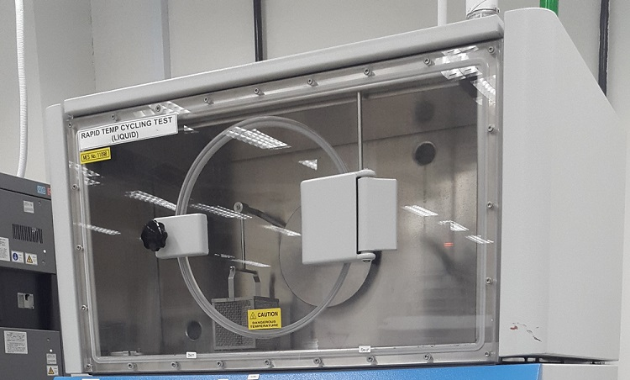
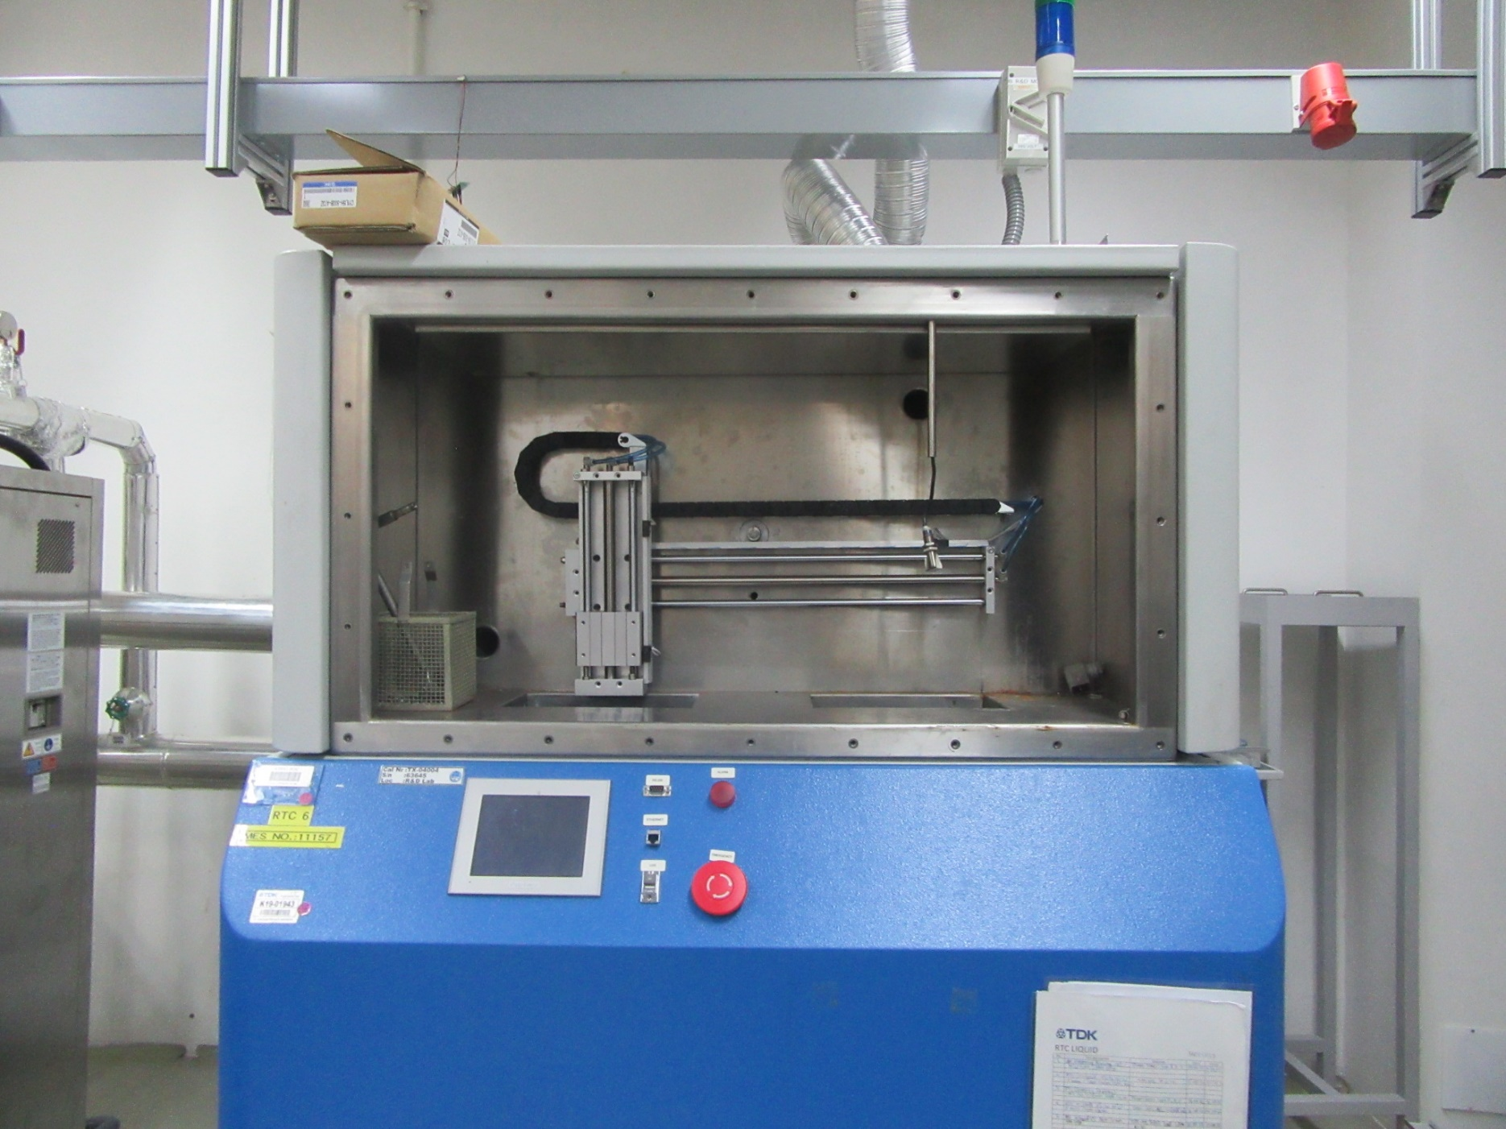
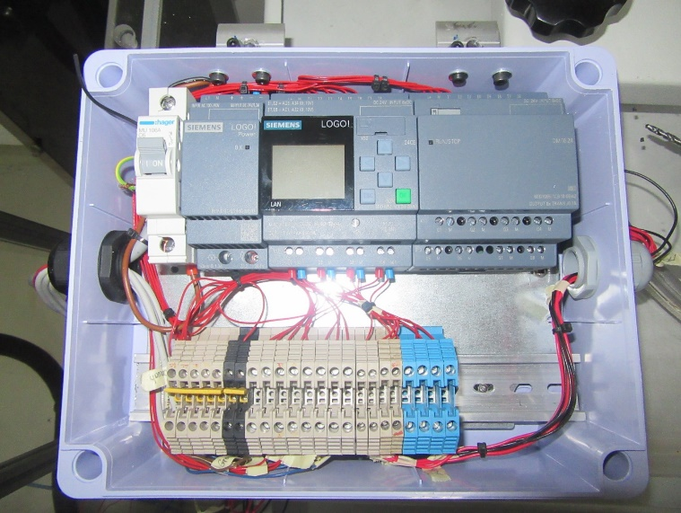
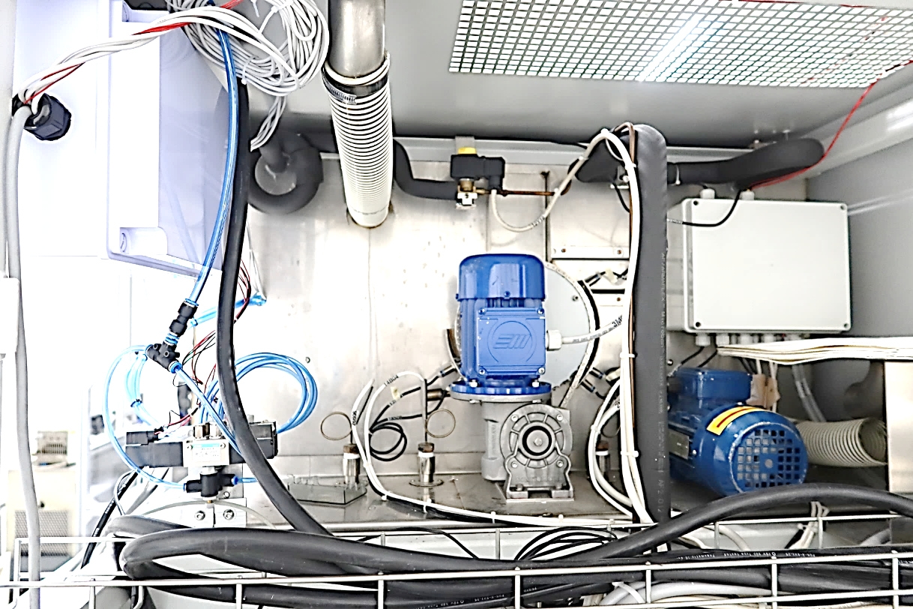
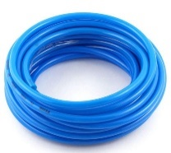
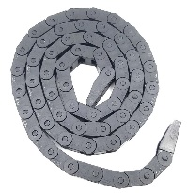
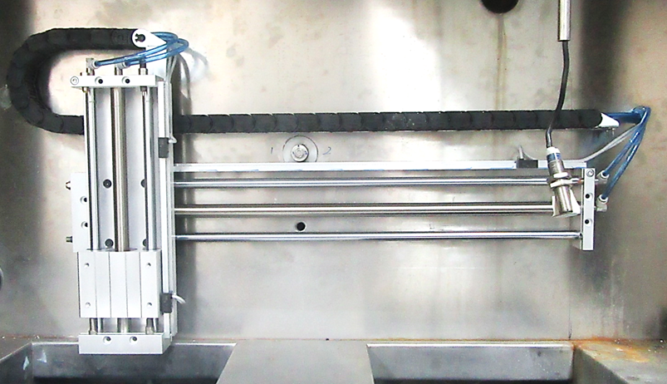
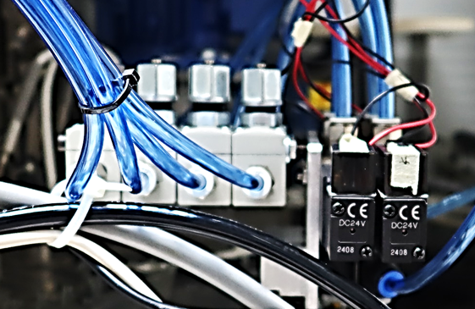

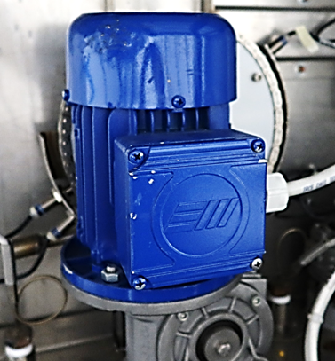
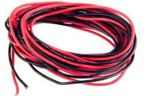
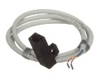
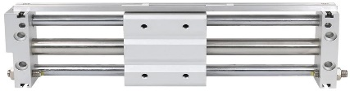

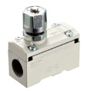
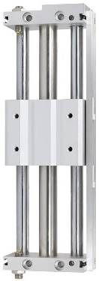
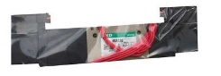
Electrical Panel
RTC Liquid Machine
Old Mechanical
New Mechanical
-/+ 8 Seconds
-/+ 4 Seconds
Chain Cable
Cables
Tubing
Solenoid
Reed Switch
Flow Speed
Control
Cylinder

Slide 4

Parts On the Electrical Panel
Panel Box
MCB 1 Phase
Power Supply
Extend Terminal I/O PLC
PLC
Plate
Terminal Block
Line
Terminal Block I/O
Terminal Block
Neutral
Omega Rail

Slide 5
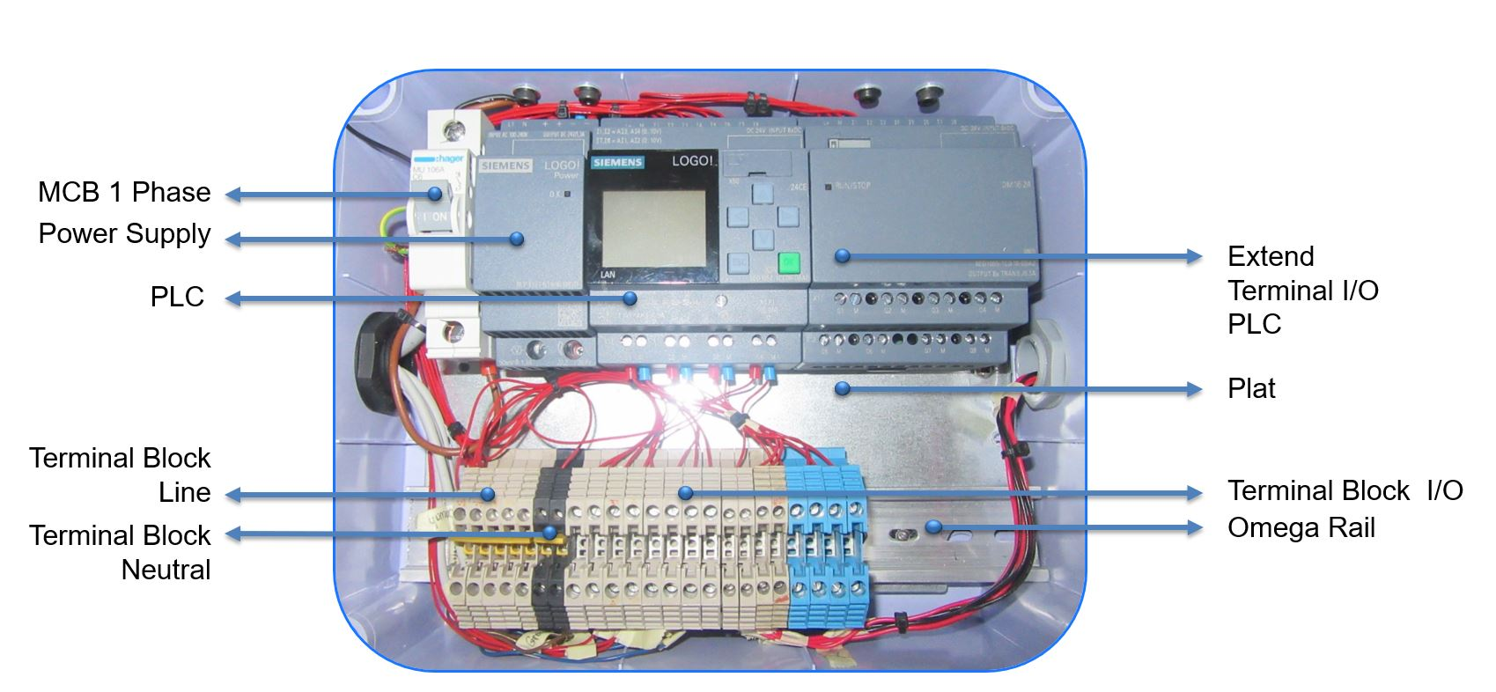
Layout Panel
For Placement Guide

Slide 6
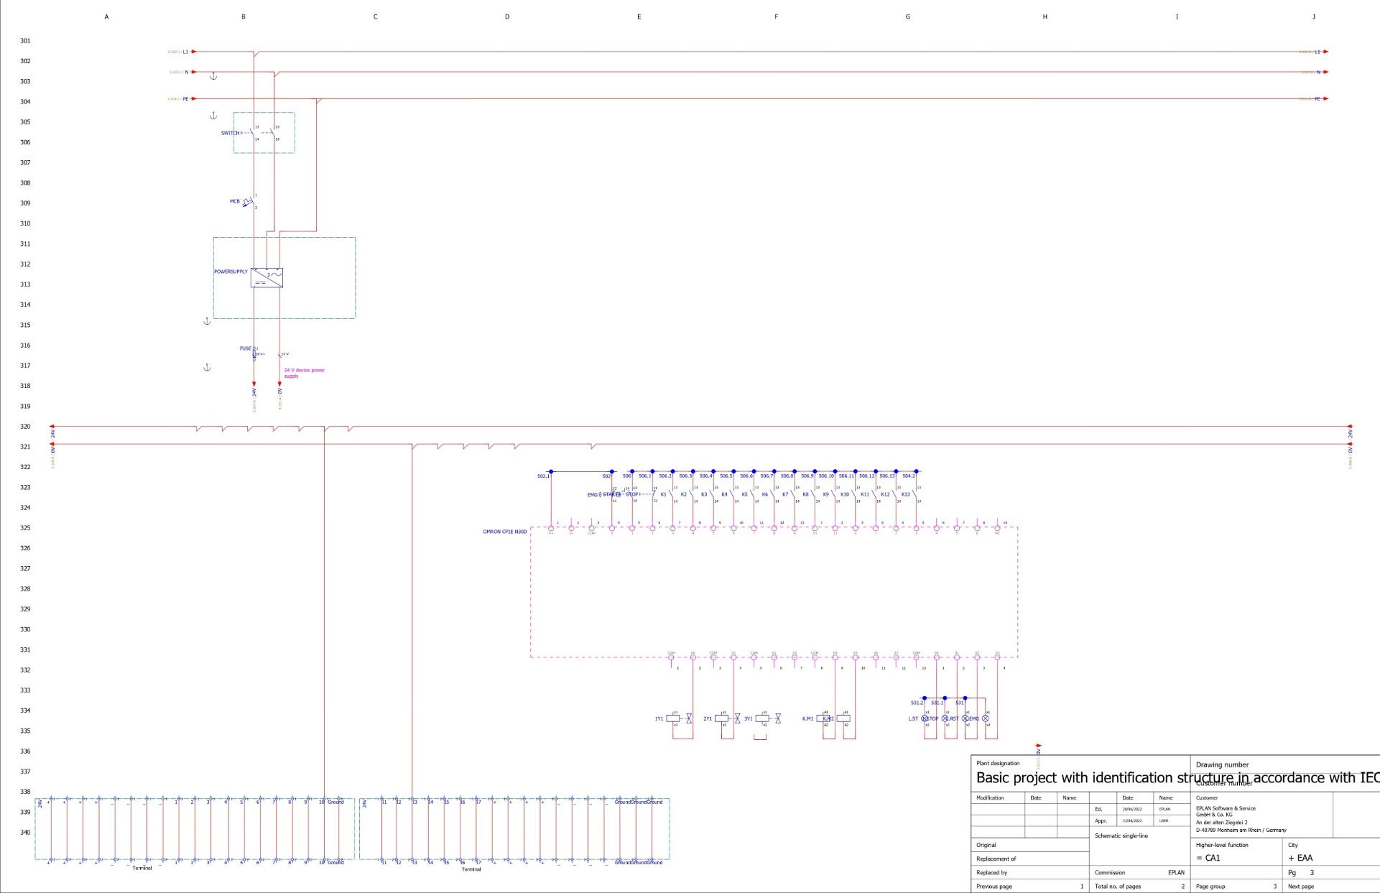
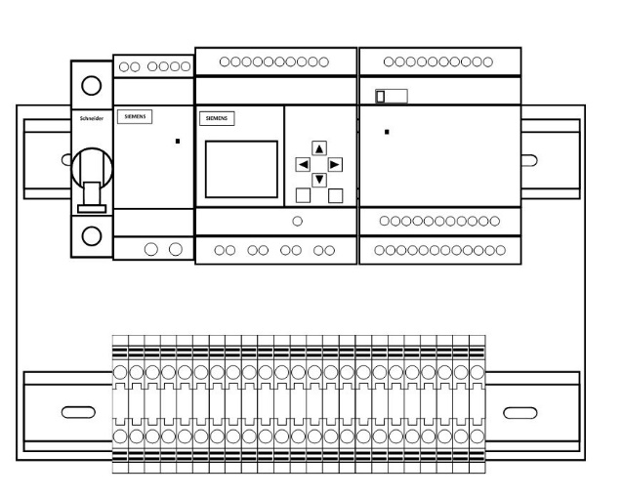
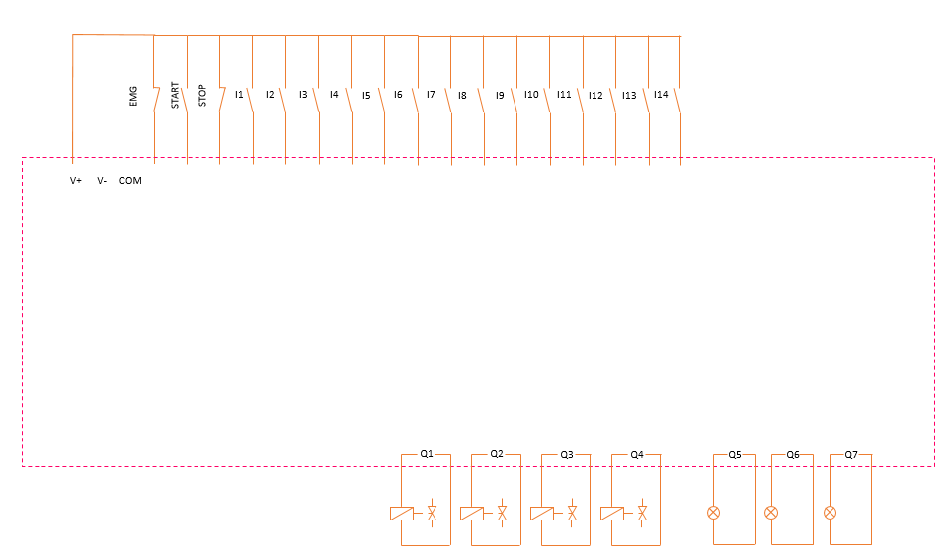
Wiring Diagram
For Wiring Guide
Power Circuit
Button & Sensors
PLC Circuit
Solenoid
Terminal

Slide 7
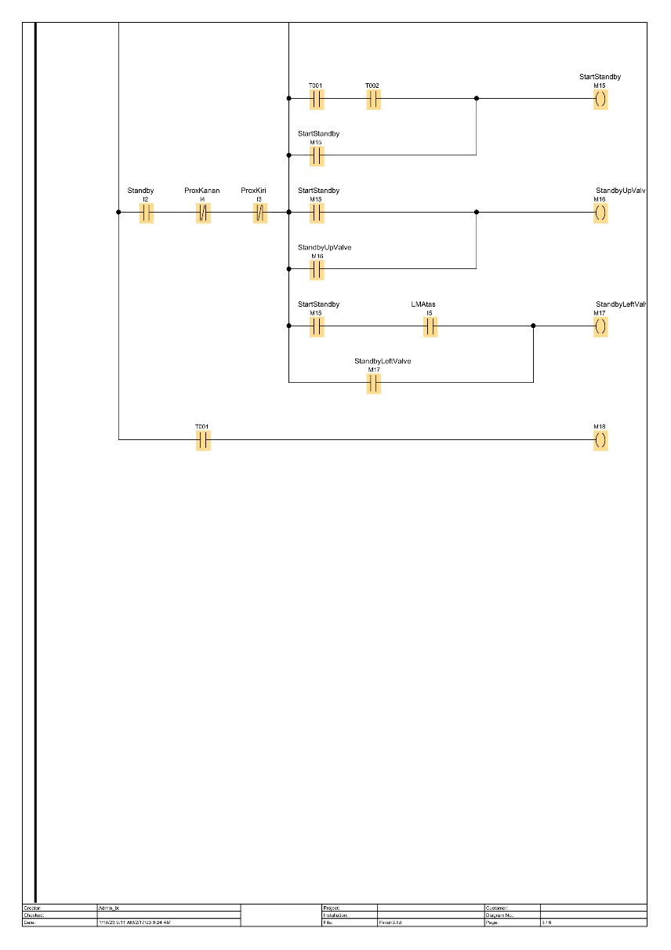
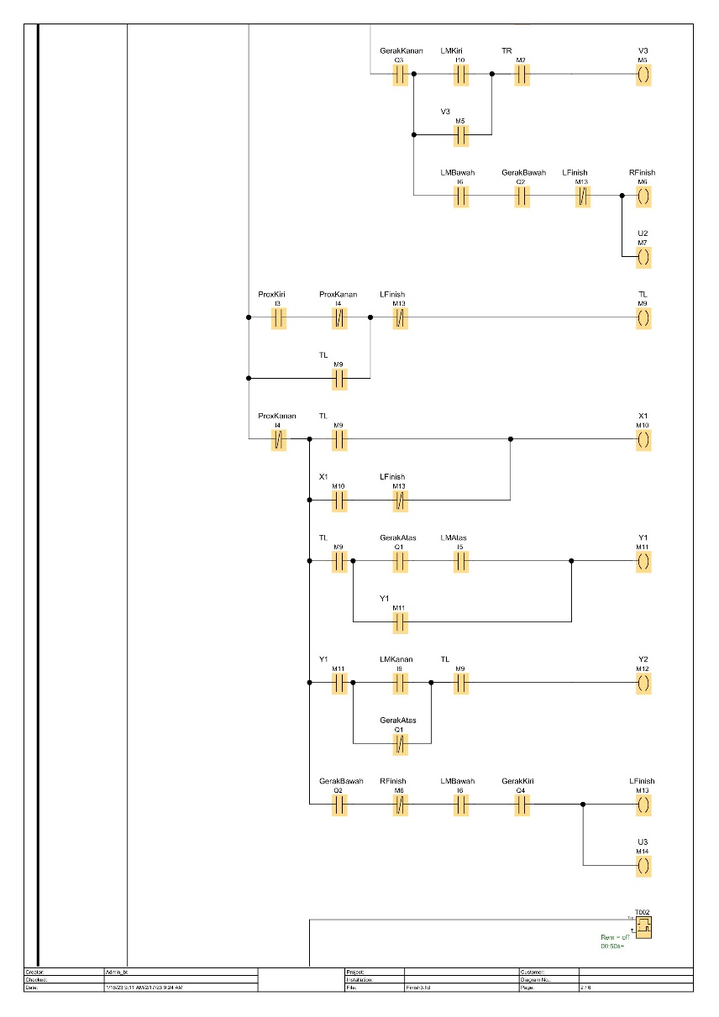
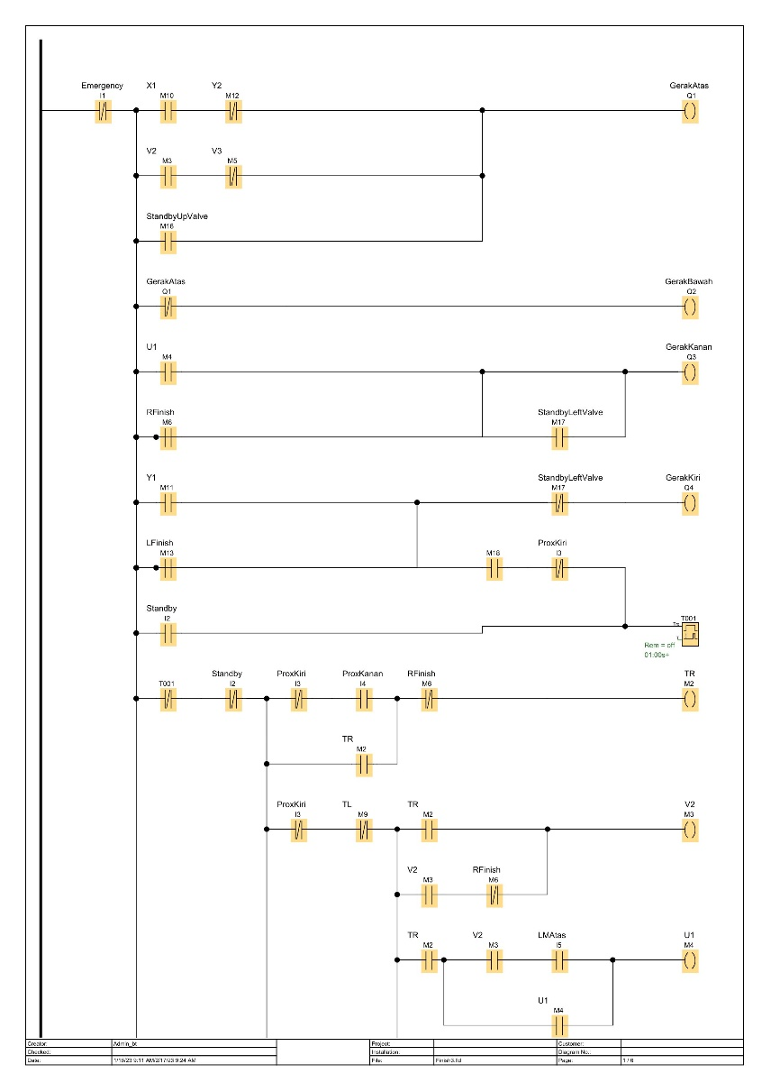
Program
To control Actuator

Slide 8
What we got ?
We are able to replace the old mechanical RTC machine with a newmechanical
We are able to make the electrical panel for a new modification RTC Machine
We are able to use electrical hand tools
We are able to read electrical schematics

